Slide 1
Part 1: Data Scraping from URL to CSV files using Python

Slide 2
Part 1:Scrapping data
Steps carried out:
Get all date fields possible values for the 15 quarters
For every single quarter, we read the data from the table on the web page and get the rank of the bank, the location, the name and the assets
This data is dumped into the csv row by row
This process is carried out for every single quarter.
Packages used:
Beautiful soup

Slide 3
Code for Scrapping
The code to scrape from a URL is in the following path:
Assignment 1_Team 6\Python Scripts\Part 1\Scrapper.py

Slide 4
STORY 1: Geographic distribution of Banks and Assets

Slide 5
1. STORYBOARD: BANKS AND THEIR ASSET DISTRIBUTION BY LOCATION FOR A PARTICULAR YEAR
BANK GEOGRAPHIC LOCATION
ASSET DISTRIBUTION BY CITIES
Banks segregated by State: The state information is broken down using Open refine through the Location column that is scrapped from the website. Using the Abbreviation of the state, the longitude and latitude values are obtained and the map is plotted.
Bank Asset by State: For a particular year, based on the state selected by the user through the map component, the distribution for the assets in that particular state display the banks asset value.
Total Number of Banks in a particular state: Based on the user selection and Year (depending on the data) we get the number of banks for a particular state.
Bank Assets by State: The state information is broken down using Open refine through the Location column that is scrapped from the website. Using the Abbreviation of the state, the longitude and latitude values are obtained and the map is plotted.
Number of Banks by State: For a particular year, based on the state selected by the user through the map component, the number of banks for the selected city are computed.

Slide 6
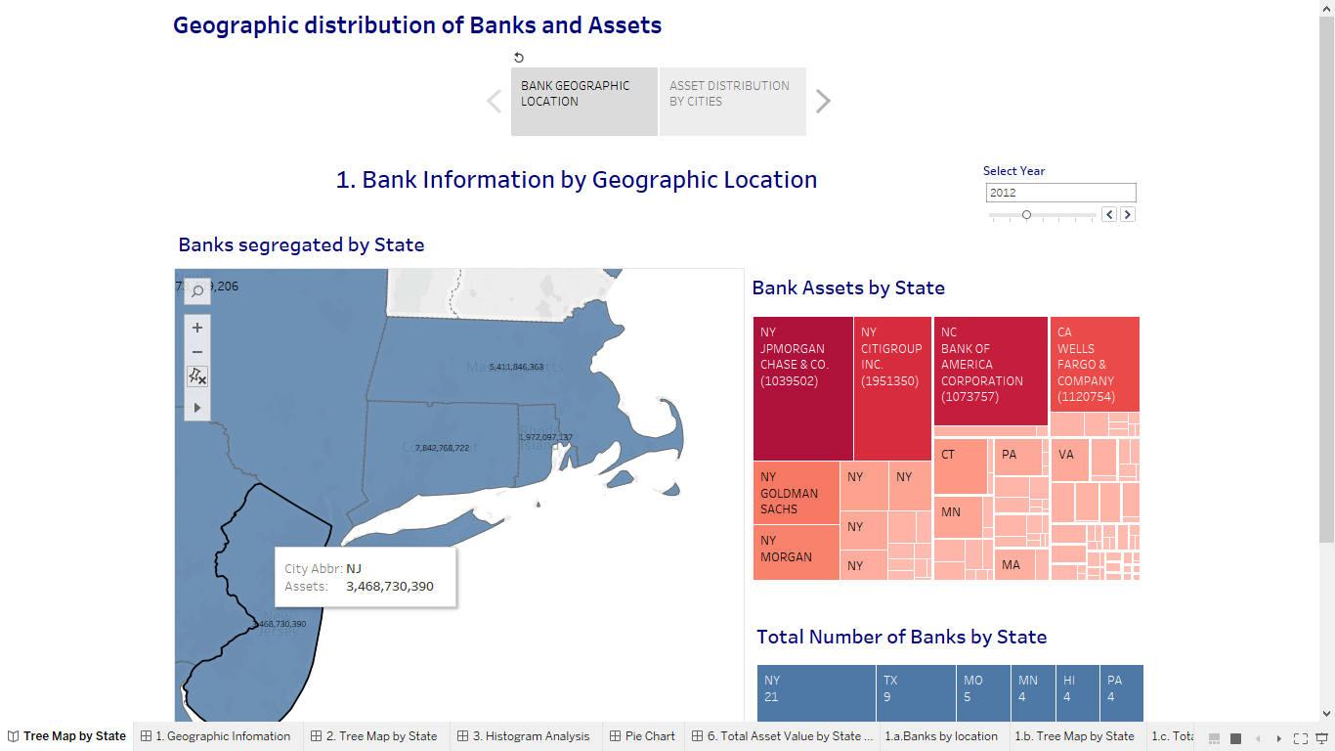
2 Dashboards for bank location distribution by stake in the market
Notes:
There are three sections to the Bank Information by Geographic location:
Banks segregated by State: The state information is broken down using Open refine through the Location column that is scrapped from the website. Using the Abbreviation of the state, the longitude and latitude values are obtained and the map is plotted.
Bank Asset by State: For a particular year, based on the state selected by the user through the map component, the distribution for the assets in that particular state display the banks asset value.
Total Number of Banks in a particular state: Based on the user selection and Year (depending on the data) we get the number of banks for a particular state.
All the graphs are connected to each other and clicking on one graph will display the updated results on all the graphs.

Slide 7
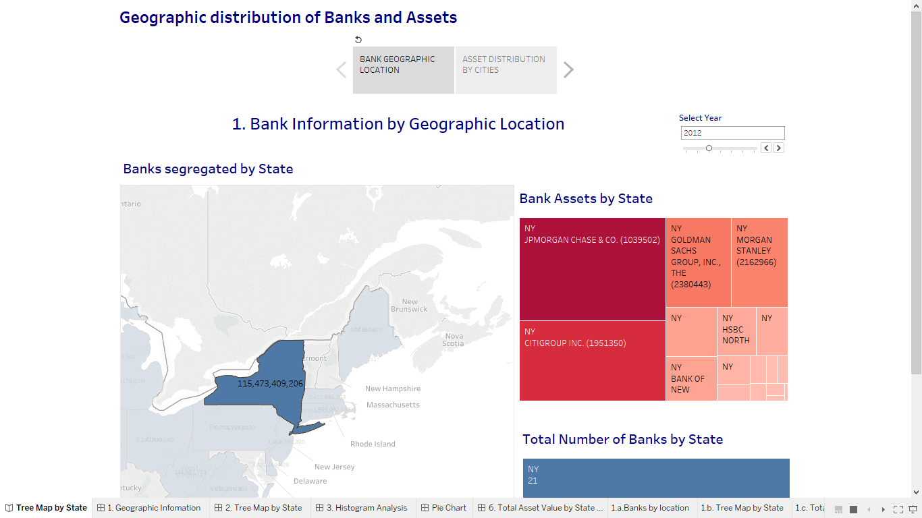

Slide 8
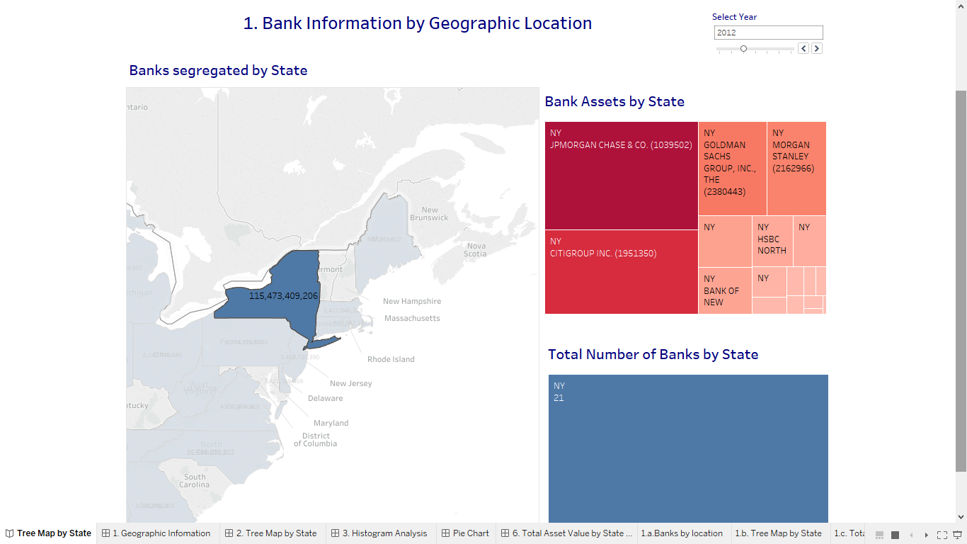

Slide 9
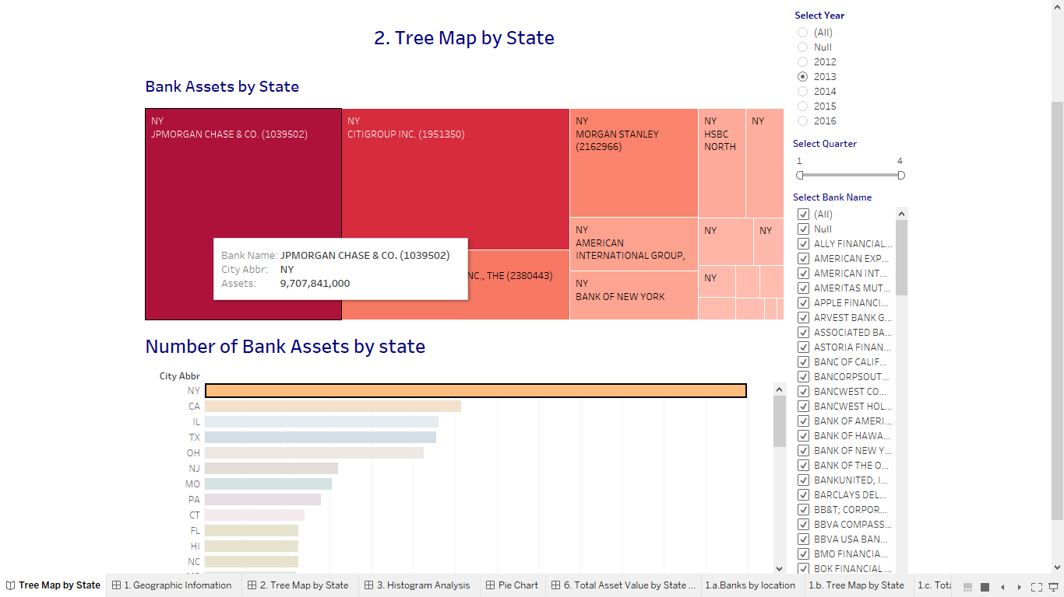

Slide 10
STORY 2:STATISTICAL ANALYSIS BASED ON BANK ASSETS

Slide 11
2. STORYBOARD: STATISTICAL ANALYSIS BASED ON BANK ASSETS
BANK ASSET ANALYSIS
BANK ANALYSIS BASED ON THE STAKE IN THE MARKET
We have used a box plot to analyze the trend that less than 10% banks own most of the net assets. (outlier analysis)
The histogram proves this fact as very few banks(count for banks) lie in the bins with higher asset values.
A pie chart is used to analyze the percentage share of net asset for a particular bank for a given year.
The size of the angle gives the sum of assets for a particular year and also the running sum of assets.
It is very easy to understand that there a very few banks that have a majority stake in the market.

Slide 12
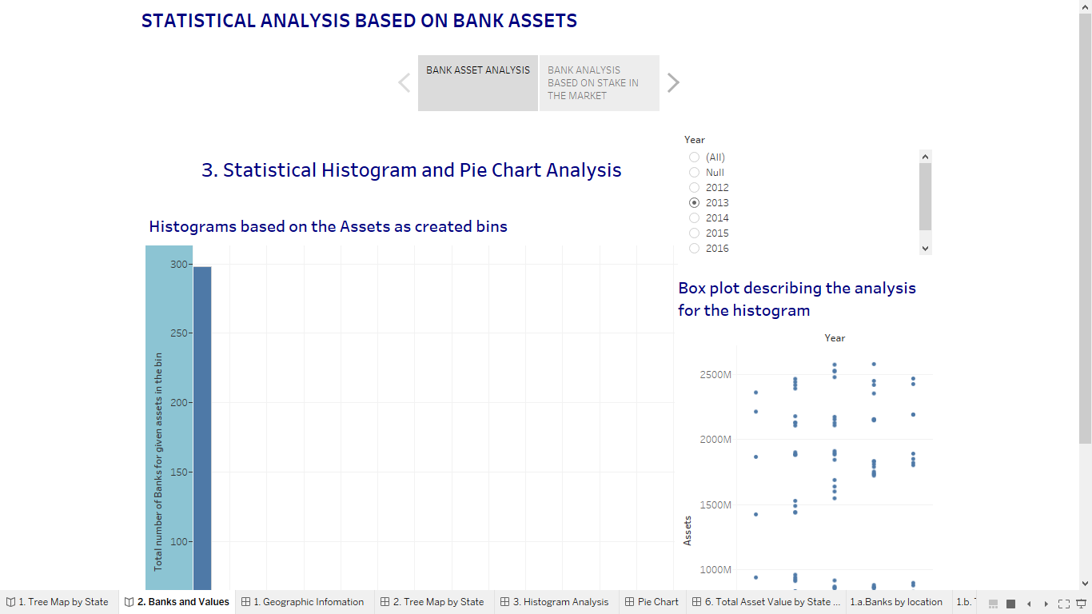

Slide 13
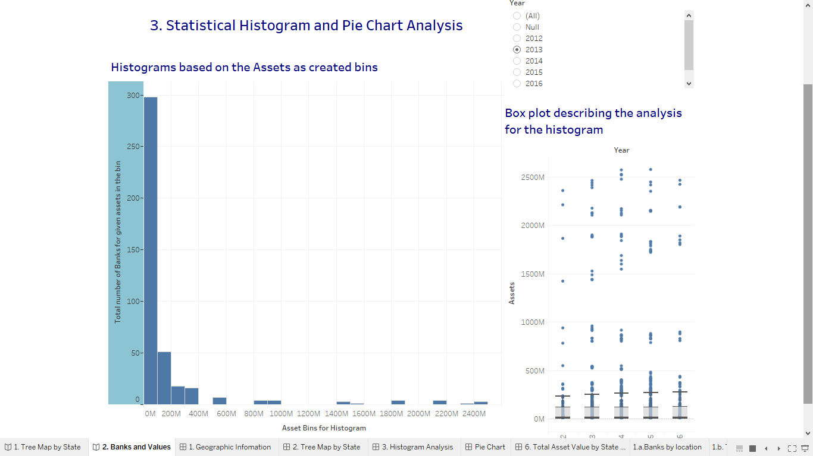

Slide 14
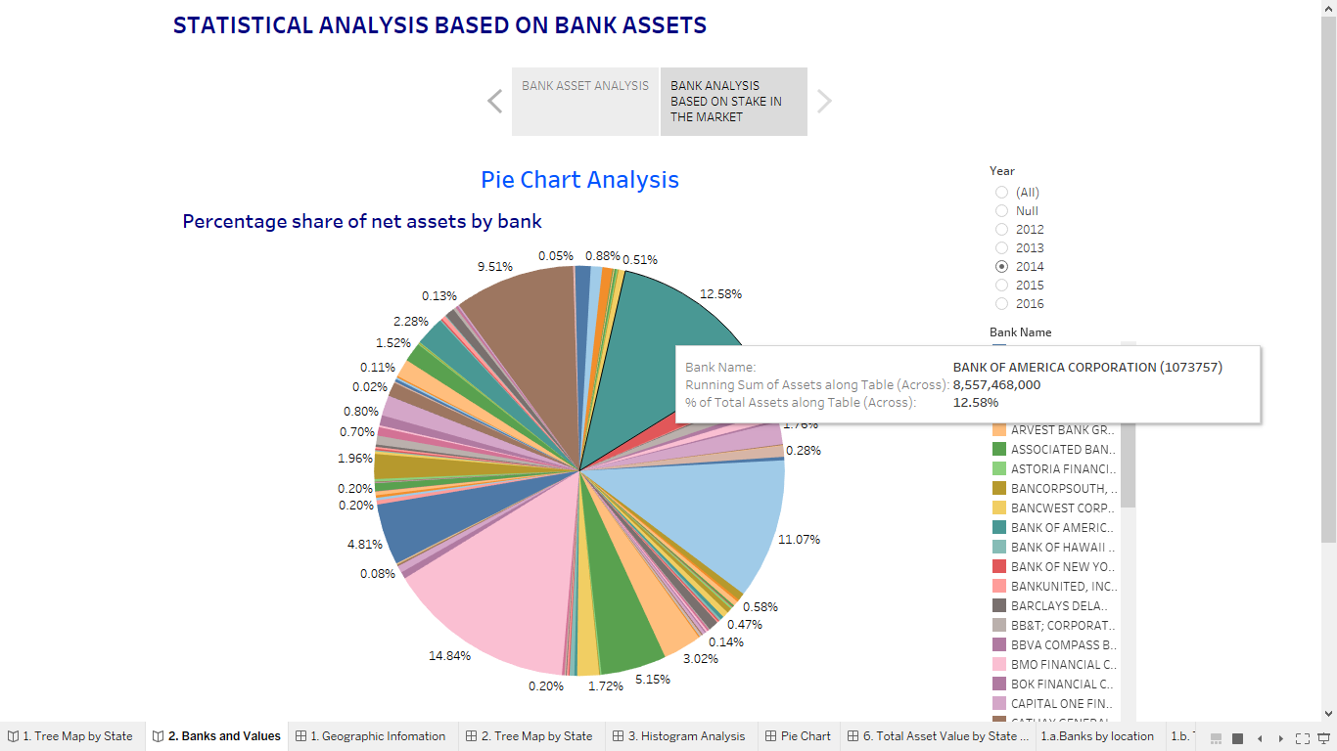

Slide 15
STORY 3: PERFORMANCE ANNALYSIS

Slide 16
3. STORYBOARD: PERFORMANCE REVIEW
TOTAL ASSETS BY QUARTER AND BY STATE
TREND ANALYSIS
Analyzed the banks based on the sum of sales by year.
The net asset value for banks is summed by state for every quarter.
The pivot table displays the assets by quarter and also the assets for a particular bank by quarter.
The measures are bucketed into 2 sets, one for over a defined value for assets, represented in red and the others below the threshold in green. (KPI created)

Slide 17
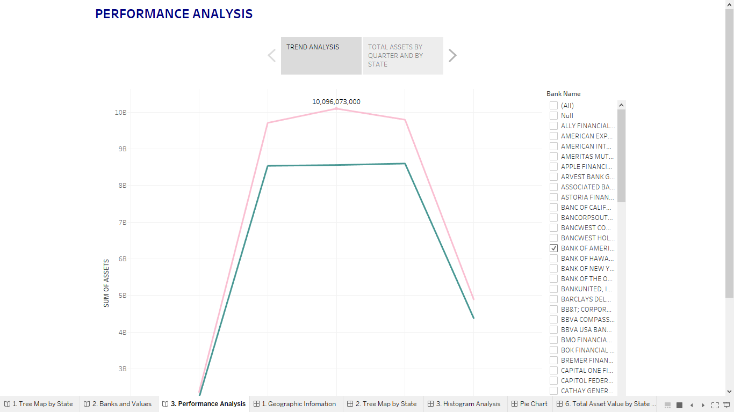

Slide 18
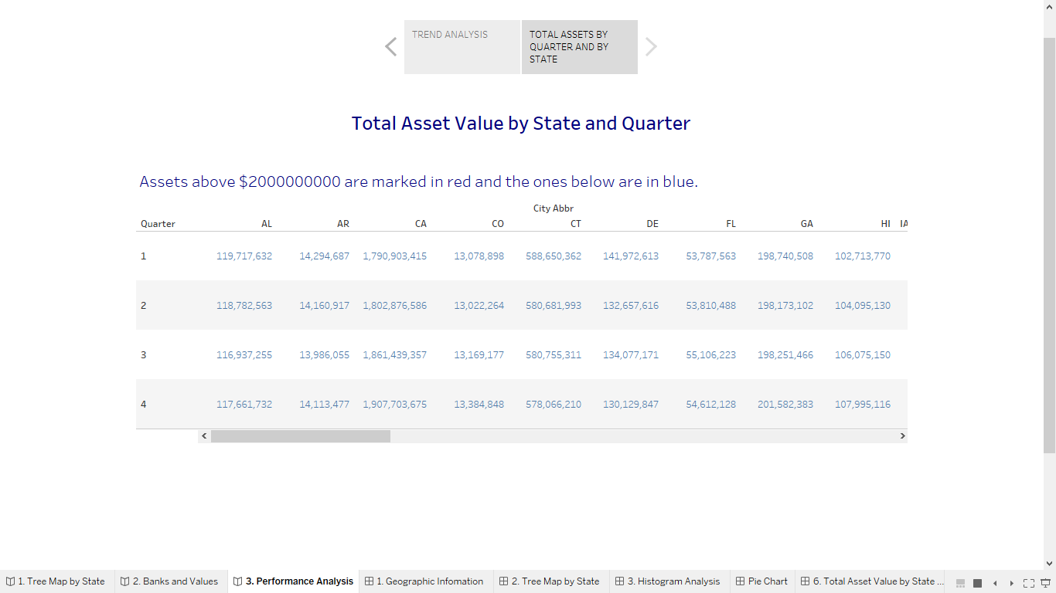

Slide 19
STORY 4: Best Performing Bank

Slide 20
Top and Bottom 10
Based on the formula: In a calculated field gives top and bottom by checking true.
index()<=10 or last()<=10

Slide 21
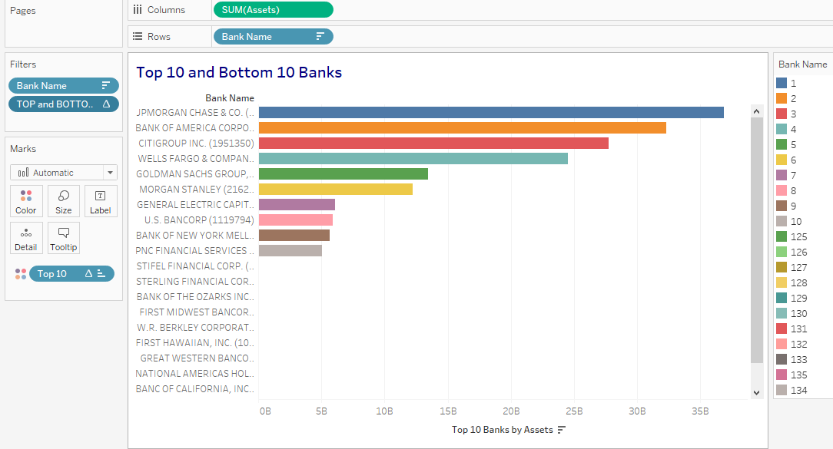

Slide 22
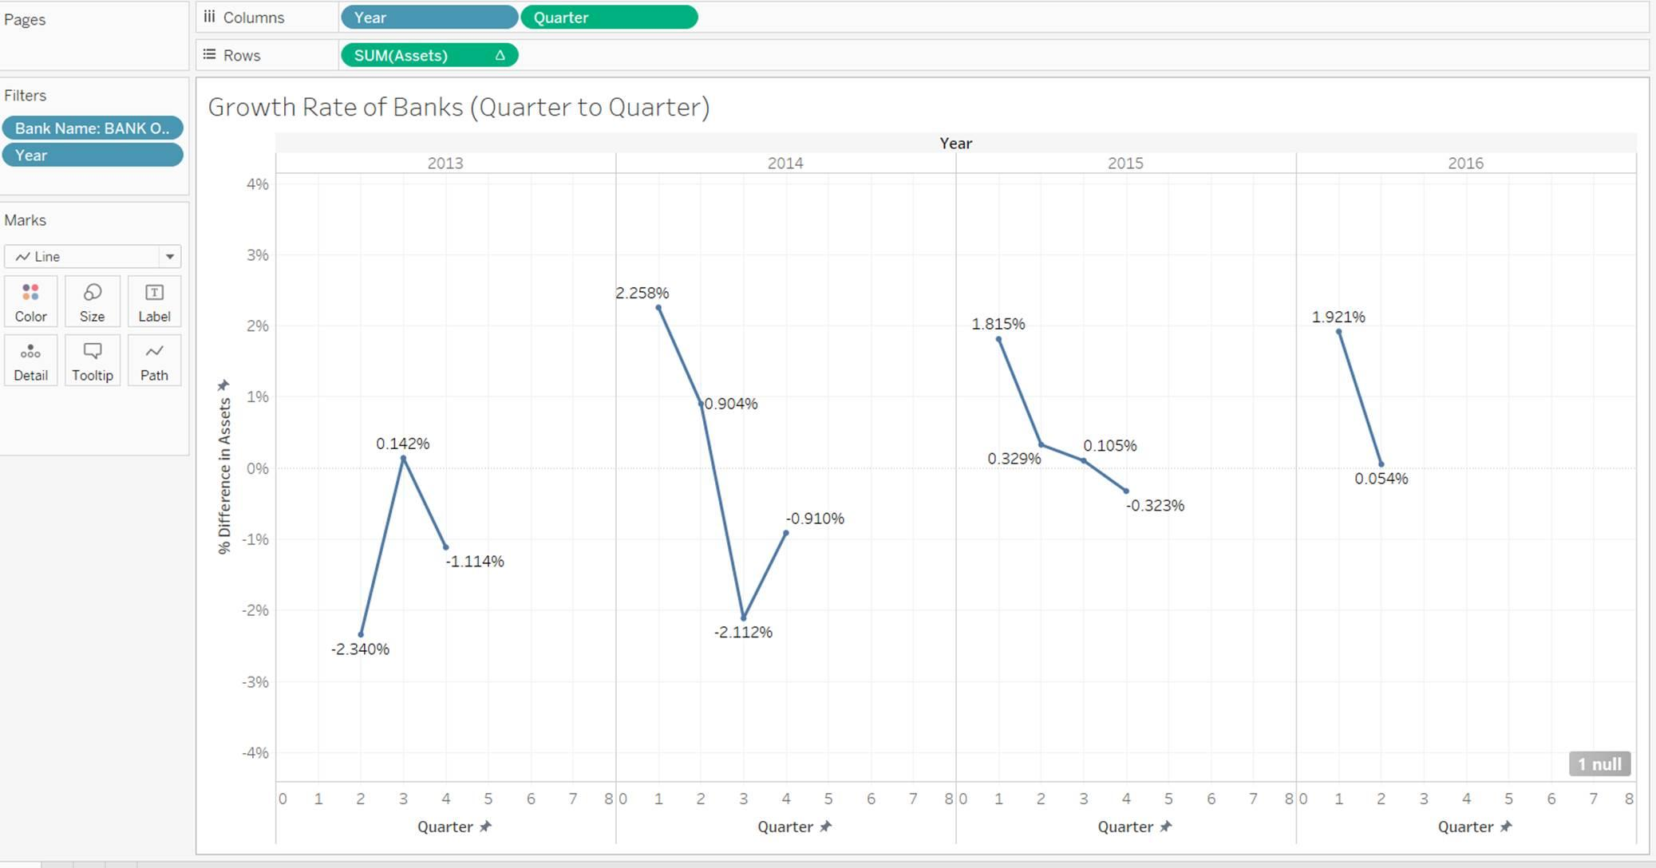

Slide 23
Part 2: Data Scraping from PDF to CSV files using Python

Slide 24
Scraping Technique Used
Find all class named ‘lightest’ using BeautifulSoup package.
Within this class check for links i.e. having <a href /> tags.
Check for links referencing “PeerGroup_1_” documents
Add all links referencing “PeerGroup_1_” in a list called finalList
Open the PDFs using the links in finalList and save the PDF documents

Slide 25
Code for saving PDF files for Peer 1 banks
from bs4 import BeautifulSoup from urllib.request import urlopen # Link for scrapping url = "https://www.ffiec.gov/nicpubweb/content/BHCPRRPT/BHCPR_Peer.htm" baseLink="https://www.ffiec.gov/nicpubweb/content/BHCPRRPT/" html = urlopen(url) finalList=[] soup = BeautifulSoup(html, "html.parser") #Code to filter in html elements tbl = soup.findAll(class_='lightest') for t in tbl: s=t.find_all('a') links=[link.attrs['href'] for link in s] for link in links: if "PeerGroup_1_" in link: finalList.append(link) #Code to save PDF documents to the local system for tempLink in finalList: navLink=baseLink+tempLink response = urlopen(navLink) tokens=tempLink.split('/') file = open(tokens[3], 'wb') file.write(response.read()) file.close() print("Completed")

Slide 26
Converting data from PDF to CSV
Target the PDFs by providing the path where the PDFs are stored.
Using pdfminer package extract the text from all the PDF documents one by one
Now open a text file and write the contents into it using file.write(data) function
By this stage all the PDF documents will be converted into text files
Now read the text files generated and separate the string based on the blank spaces in between using split() function.
Read line by line and append to the list.
Use csv package to write strings in the list to the csv file.
csv.writer() and csv.writerow() functions can be used for this.

Slide 27
Code for converting PDF to CSV
import glob import os import io import PyPDF2 import csv from pdfminer.pdfpage import PDFPage from pdfminer.pdfinterp import PDFResourceManager, PDFPageInterpreter from pdfminer.layout import LAParams from pdfminer.converter import TextConverter i=0 token=[] path = 'D:\Scrapper2\\' for filename in glob.glob(os.path.join(path, '*.pdf')): filePath = open(filename, 'rb') #breaking paths token = filename.split('\\') fToken=token[-1].split('.') #Parameters for Reading PDFs codec = 'utf-8' retString=io.StringIO() laparameters = LAParams() resourceManager = PDFResourceManager() device = TextConverter(resourceManager, retString, codec=codec, laparams=laparameters) interpreter = PDFPageInterpreter(resourceManager, device) fileToWrite =fToken[0]+".txt" fileToWriteCSV=fToken[0]+".csv" baseLocationText="D:\Scrapper2\TextFolder\\"+fileToWrite baseLocationCSV="D:\Scrapper2\CSVs\\"+fileToWriteCSV #Traversing the pages for page in PDFPage.get_pages(filePath): interpreter.process_page(page) data = retString.getvalue() #Opening a text file to convert PDF to Text file = open(baseLocationText,'w') file.write(data) file.close() #Read the text file and Open the CSV file to write reads=open(baseLocationText,"rt") with open(baseLocationCSV,"w") as out_file: for line in reads: listwords=line.split(" ") while '' in listwords[1:]: listwords.remove('') out_csv = csv.writer(out_file) out_csv.writerow(listwords) out_file.close()

Slide 28
Review and Comments on data
Since usually PDF is not converted back to text these are the issues faced
Additional line is added while converting PDF to CSV
There is no continuity in headers

Slide 29
Part 3: Graphs and Time Series Analysis

Slide 30
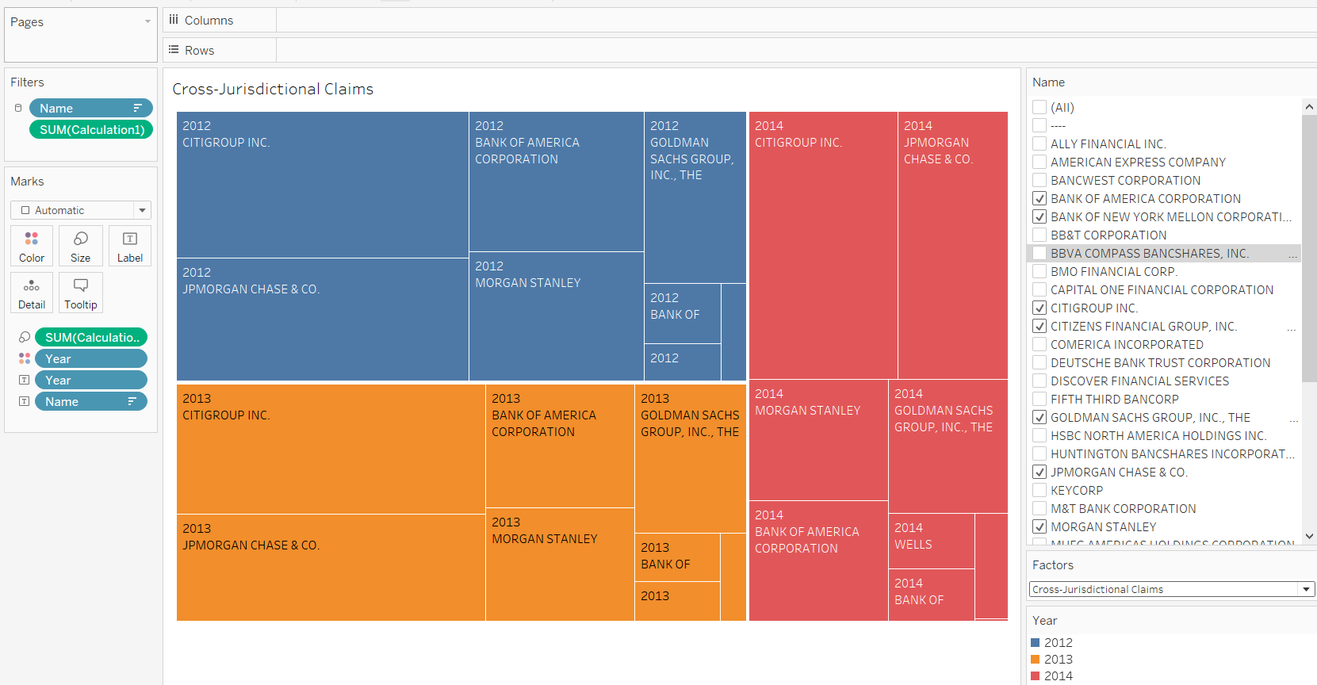
Comparison of Institution’s Cross-Jurisdictional Claims over years

Slide 31
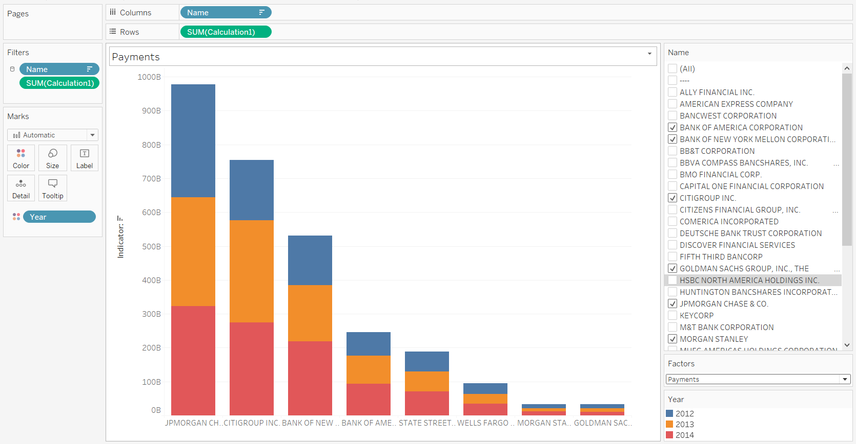
Comparison of Institution’s Payments over years

Slide 32
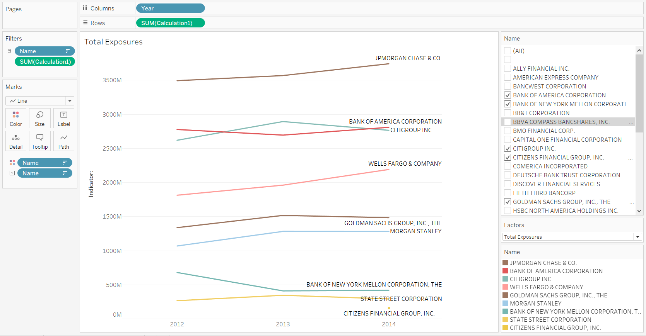
Year to Year Analysis of Total Exposures of Institutions

Slide 33
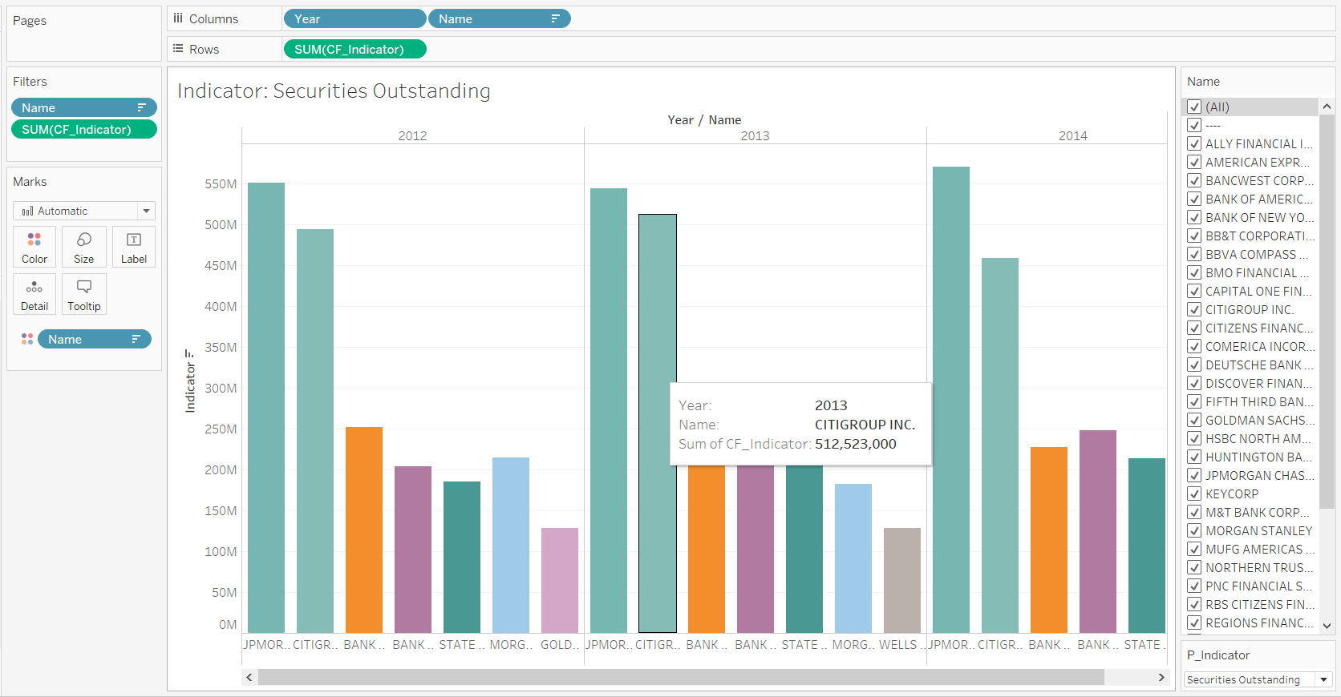
Comparison of Institution’s Securities Outstanding over years

Slide 34
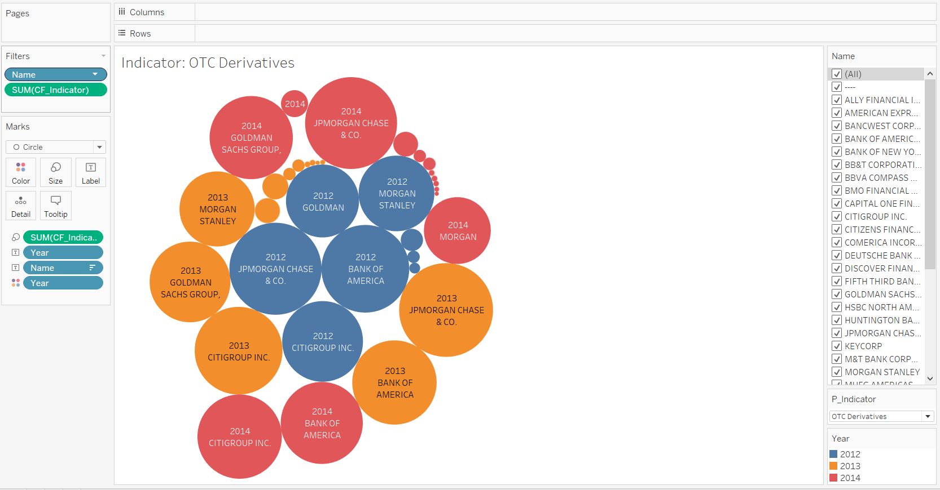
Comparison of Institution’s OTC Derivatives over years

Slide 35
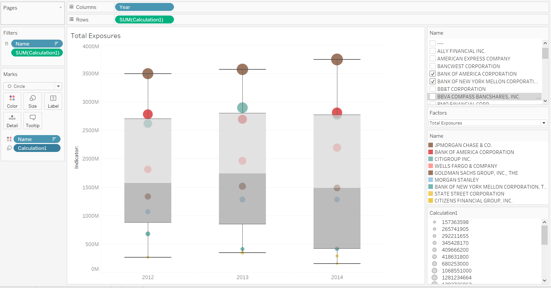
Comparison of Institution’s Total Exposures over years

Slide 36
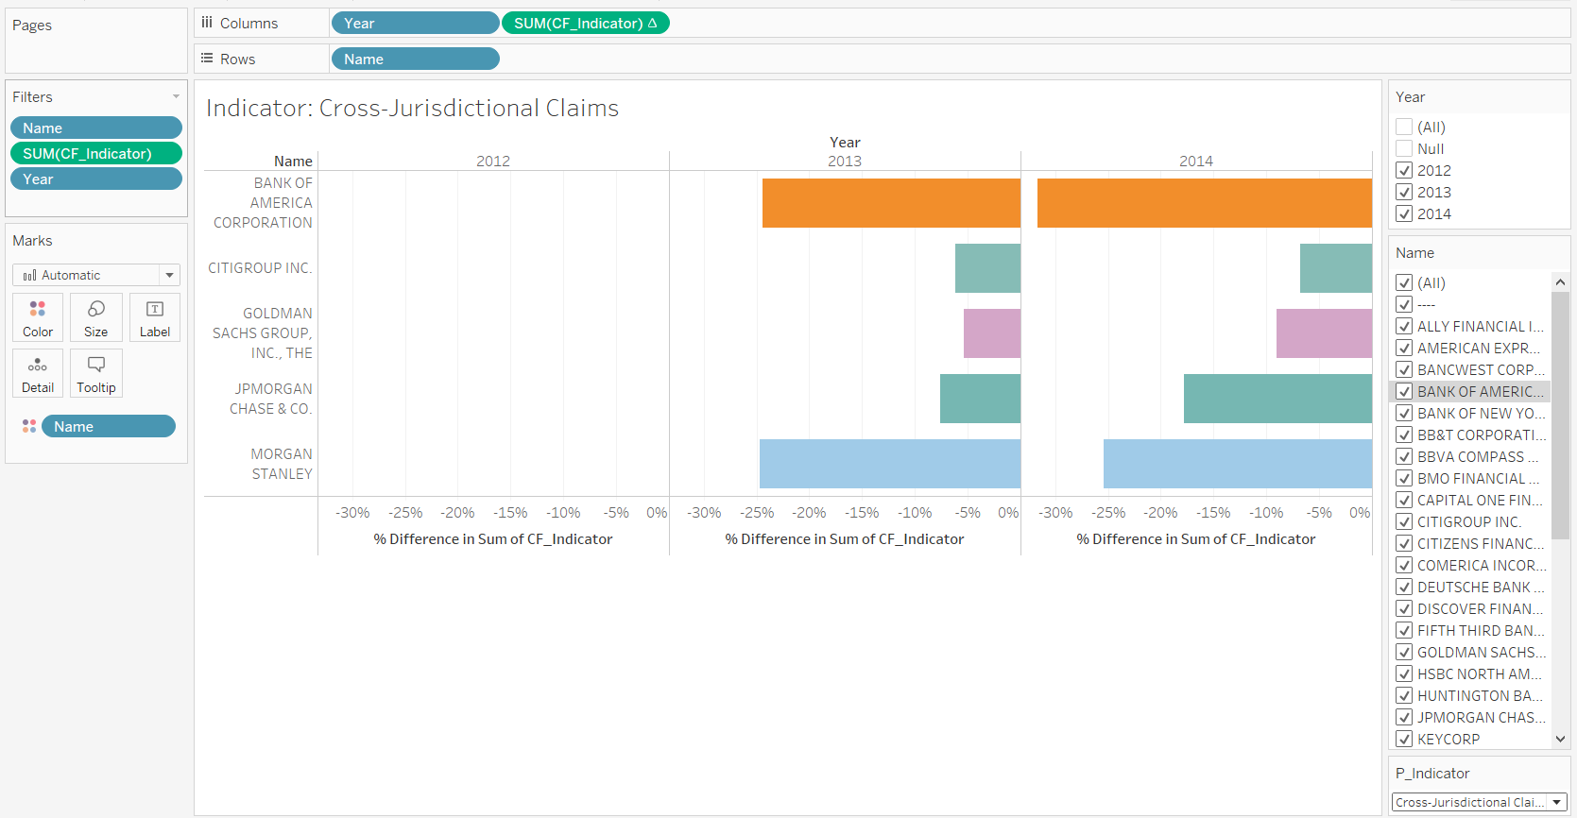
Year on Year Percentage change in Cross Jurisdictional Claim

Slide 37
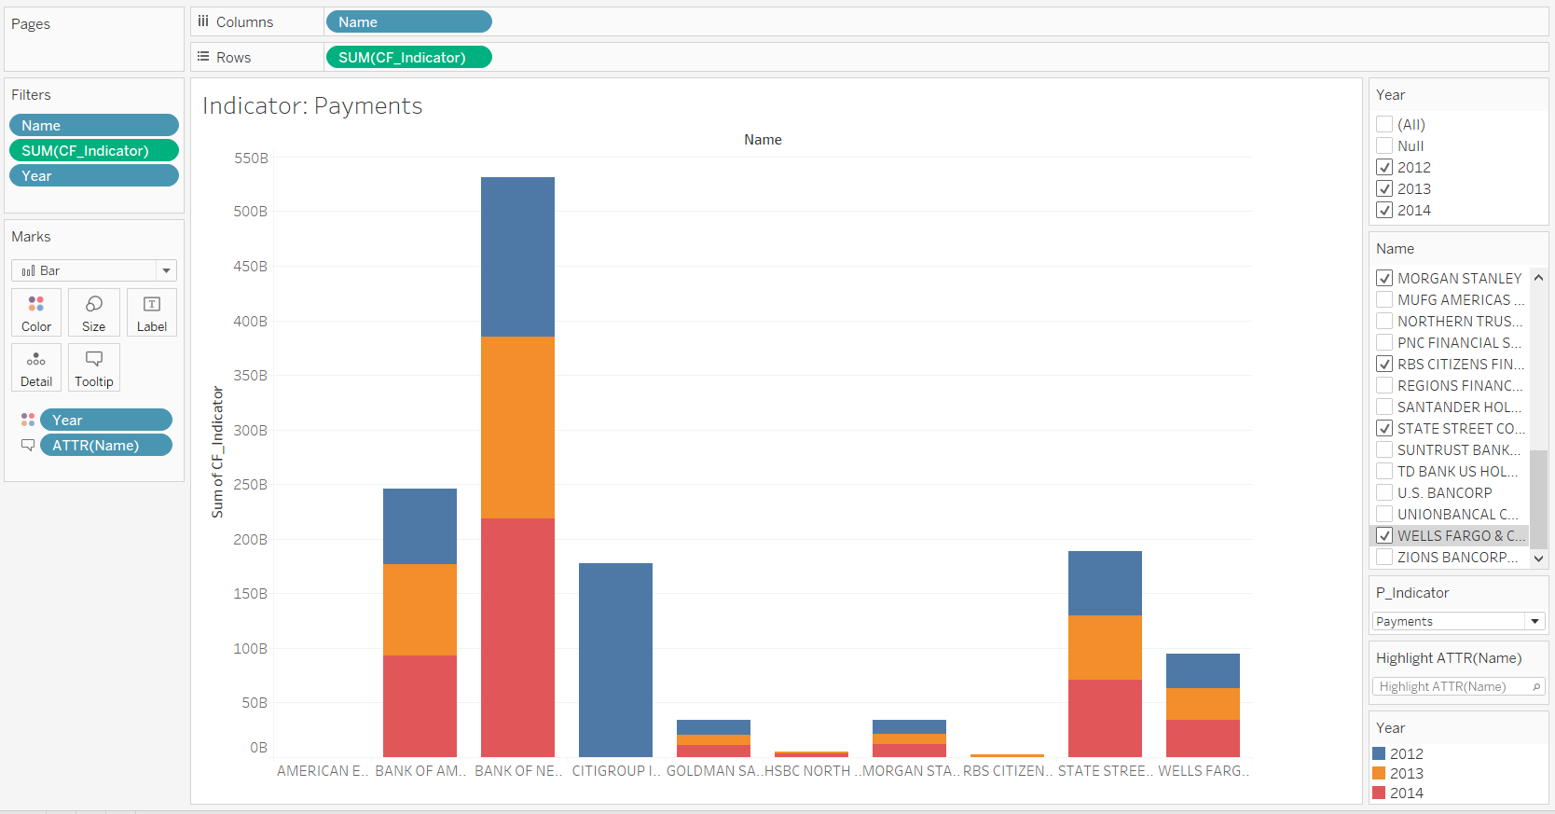
Year over Year Analysis of Institutions Payment

